Slide 1
SENTIMENT ANALYSIS OF ICE CREAM SHOPS
PREPARED AND SUBMITTED BY:
JIJO JOHN JOSEPH(200521777)
Submitted To:
Prof. Robin Huang -BDAT 1007

Slide 2

Introduction
Yelp is a renowned platform where customers express their experiences with various businesses.
These reviews are a goldmine of data that, when analysed correctly, can provide valuable insights into customer satisfaction.
This project proposes a system to scrape reviews of Ice Cream shops in Toronto from Yelp, analyse the sentiment of these reviews, and visualize the results in a user-friendly manner

Slide 3

BUSINESS USECASES
Customer Experience Improvement: By understanding the sentiment of the reviews, businesses can identify areas where customers are not satisfied and take necessary actions to improve.
Product/Service Development: Sentiment analysis can help businesses understand what features or aspects of their product or service customers like or dislike.
Marketing Strategy: Understanding customer sentiment can also inform a company’s marketing strategy. For example, positive sentiments can be highlighted in promotional materials, while negative sentiments can indicate where marketing messages need to be adjusted.
Competitive Analysis: The sentiment analysis can also be used to compare a company’s performance with its competitors. If a competitor has better reviews, the company can analyze why this is the case and make necessary changes.
Trend Analysis: Over time, sentiment analysis can help identify trends in customer sentiment, which can be invaluable for strategic planning.

Slide 4
PROJECT STAGES
Data Collection
We will scrape reviews from Yelp using a web scraping python script. The data will include the review text, rating, and other relevant information.
Data Storage
The scraped data will be stored in MongoDB, a NoSQL database. This will allow us to efficiently store and retrieve the data.
Data Processing
We will use RapidMiner to read the data from MongoDB using the Read MongoDB operator. The data will then be converted from JSON format to a format suitable for analysis. Clean the data for non-alphanumeric values
Sentiment Analysis
We will use the Sentiment Analysis operator in RapidMiner to analyse the sentiment of the reviews. This will involve training a machine learning model on a labelled dataset and then applying this model to the Yelp reviews.
Result Storage
The sentiment values will be generated as attributes and stored in another collection in the MongoDB database.
Data Visualization
We will use Flask, a Python web framework, to create a web application for visualizing the sentiment analysis results.

Slide 5
Implementation Plan
Set up the MongoDB database.
Develop the web scraping python script to collect Yelp reviews and Business Names.
Store the scraped data in MongoDB in a collection named Collection 3.
Develop the RapidMiner process for reading the data, converting it, and performing sentiment analysis.
Store the sentiment analysis results in MongoDB.
Develop the Flask application for data visualization.
Test the entire system and make necessary adjustments.
Launch the system and start collecting and analysing Yelp reviews.

Slide 6
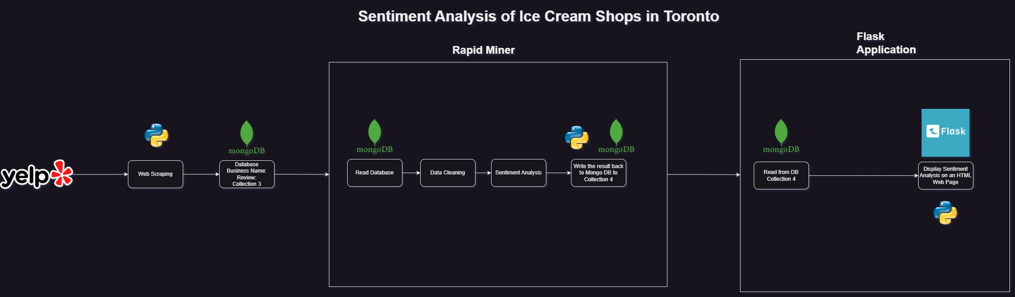
Design Diagram

Slide 7
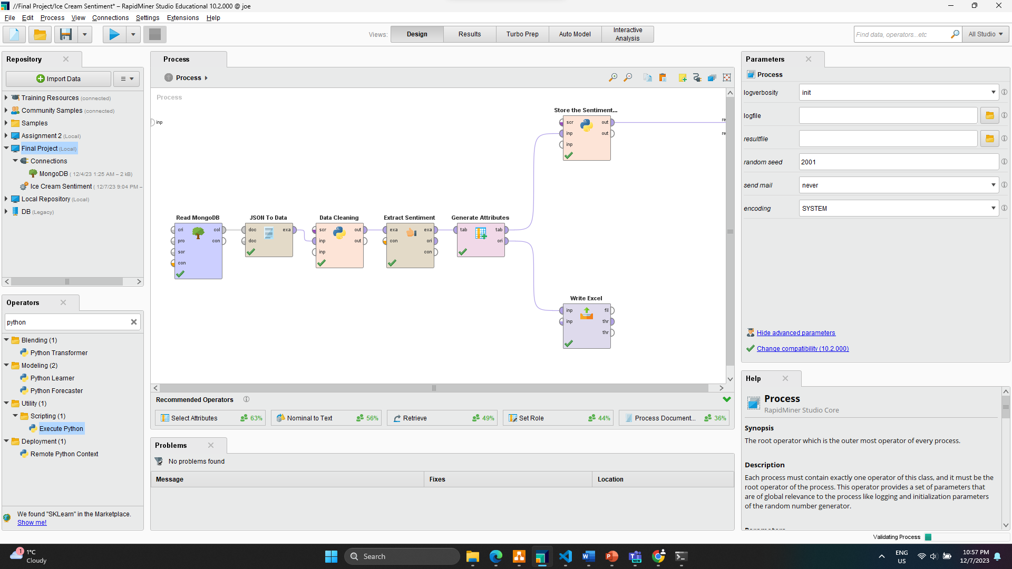
RAPID MINER PROCESS

Slide 8
RAPID MINER OPERATORS
Read Mongo DB
Data Cleaning- Execute Python
To read the scrapped data from MongoDB
We use a python script to remove all non-alpha numeric characters
JSON to DATA
Extract Sentiment
Convert data stored in Mongo DB which is in JSON format to a format that is suitable for sentimental analysis.
Operator used to get the sentiment value of the reviews.

Slide 9
RAPID MINER OPERATORS
Generate Attribute
Data Cleaning- Execute Python
The sentiment score is converted using an expression for Positive, Negative and Neutral reviews
We use a python script to remove all non-alpha numeric characters
Store the Sentiment Values- Execute Python
Write Excel
Using a python script we will store the values back to Mongo DB
Operator to generate n Excel file with the output .

Slide 10
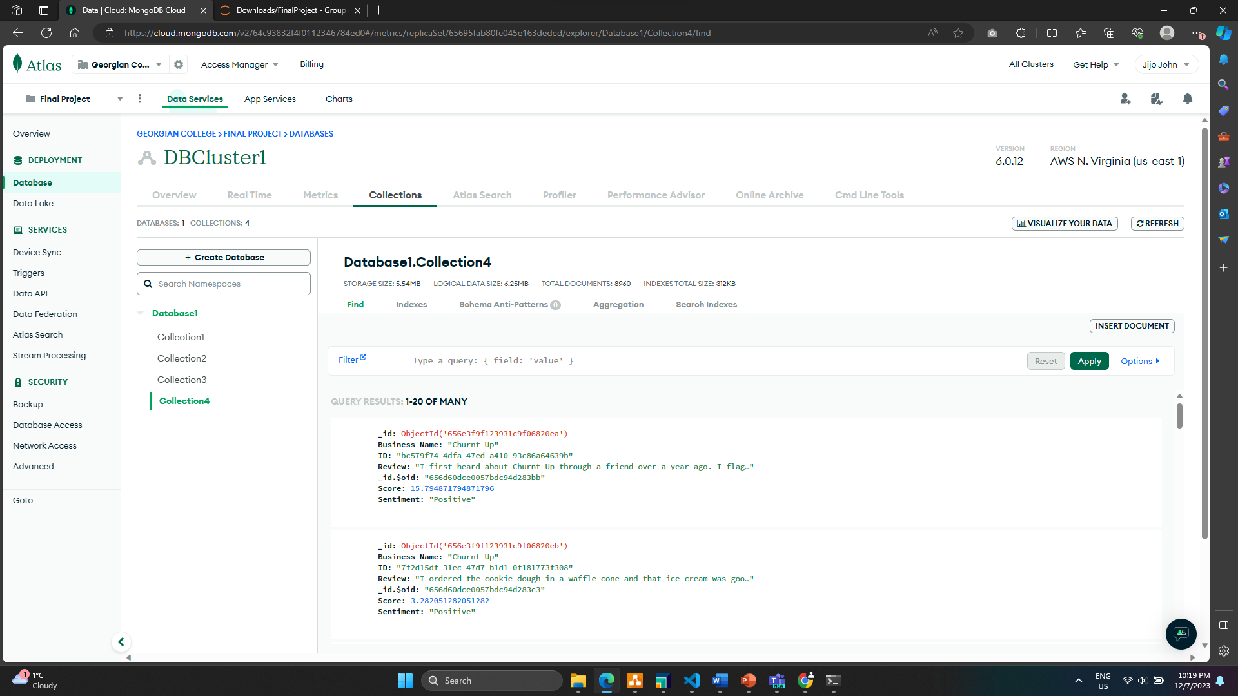
DATABASE

Slide 11
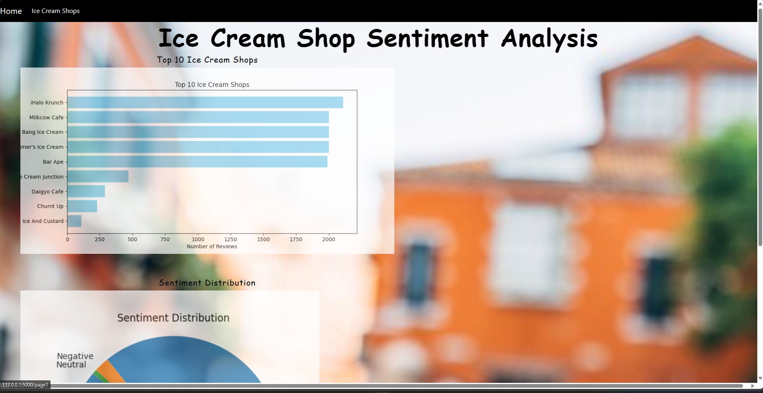
FLASK WEB APP

Slide 12
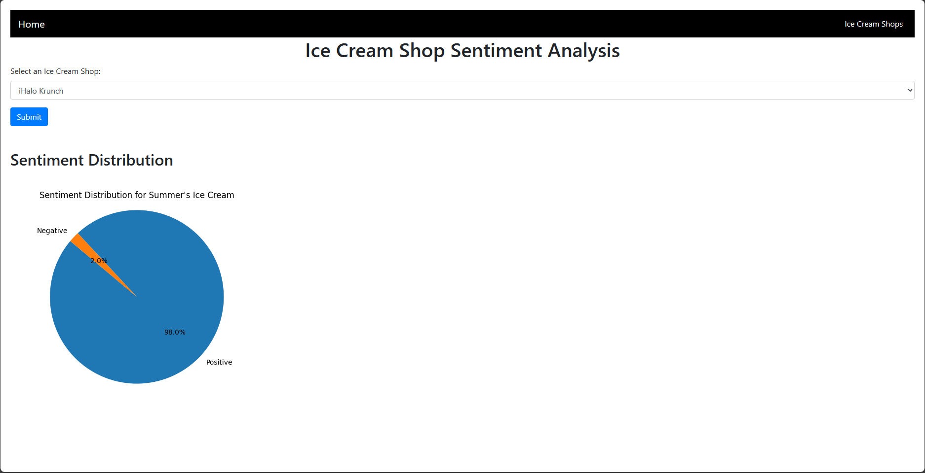
FLASK WEB APP

Slide 13
CONCLUSION
This project gives us valuable insights into customer sentiment and help improve the service of ice cream shots.
By investing more on to this project, we can increase customer satisfaction and increase revenue.
This tool would be helpful for tourists and new comes in Toronto to visit ice cream shops in Toronto.

Slide 14

Thank you

